Slide 1

Predicting customer buying behaviour
By K.Poornima
07/03/2022

Slide 2
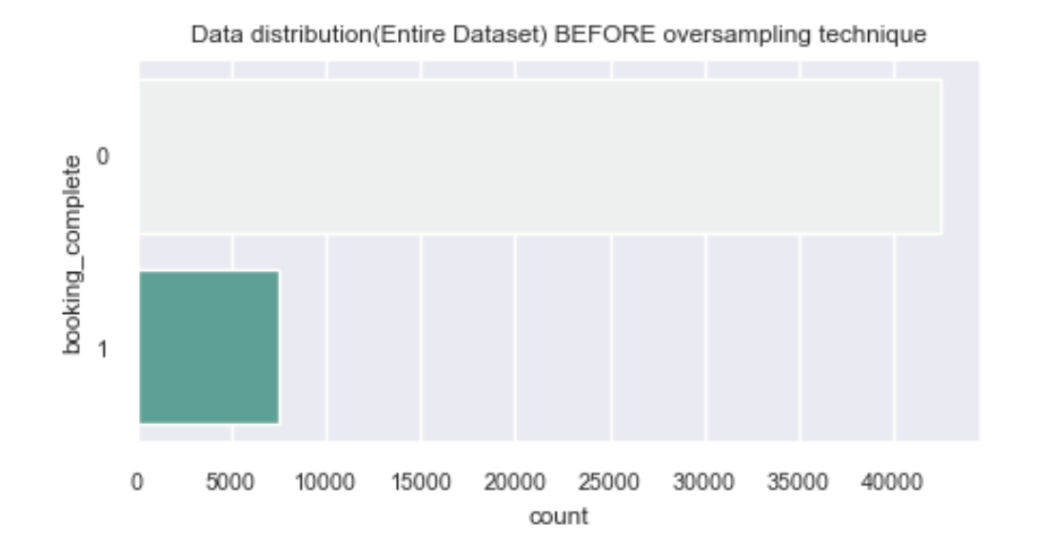
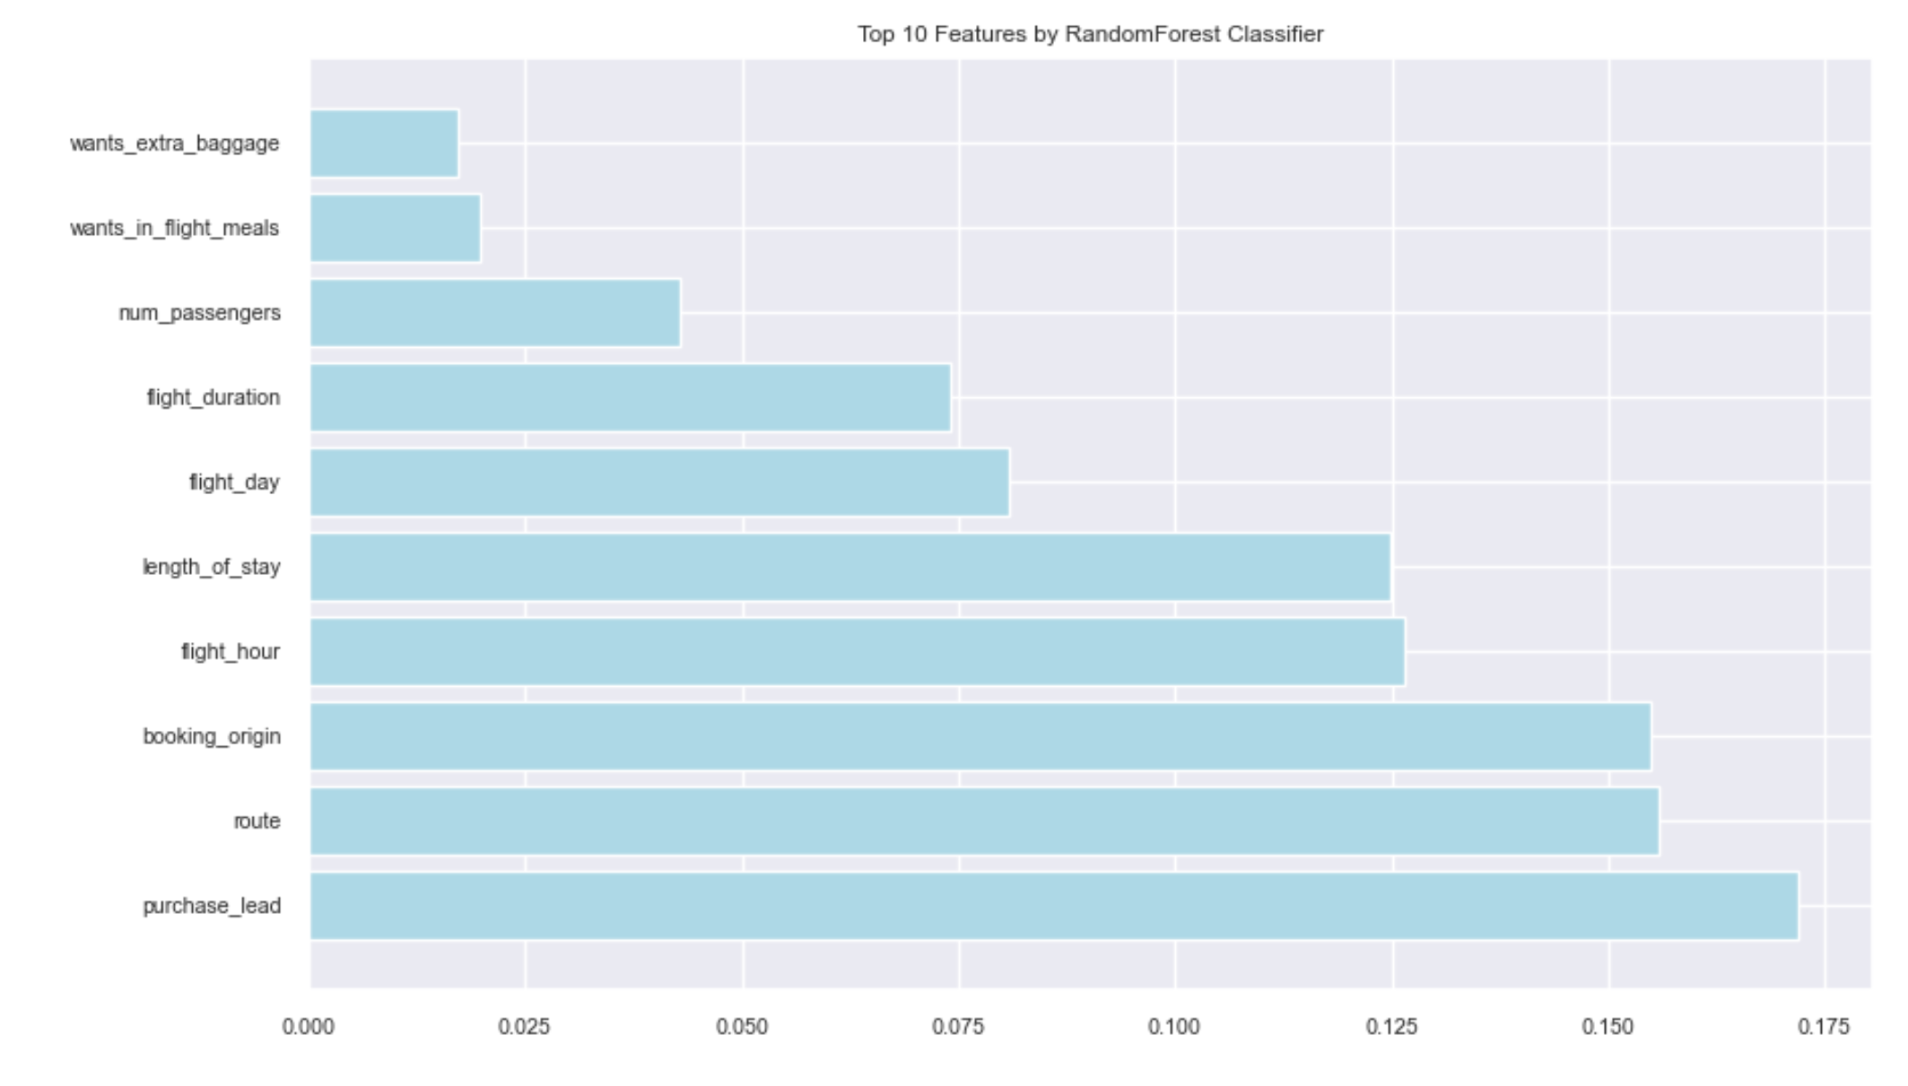
PREDICTING CUSTOMER BUYING BEHAVIOR, UNDERSTANDING FACTORS THAT WOULD INFLUENCE THE PATTERN
TPOT AUTOML GENERATED THE BEST MODEL:
Generation 5 - Current best internal CV score: 0.9791152263374485 Best pipeline: ExtraTreesClassifier(GradientBoostingClassifier(ExtraTreesClassifier(input_matrix, bootstrap=False, criterion=gini, max_features=0.15000000000000002, min_samples_leaf=1, min_samples_split=4, n_estimators=100), learning_rate=0.5, max_depth=9, max_features=0.9000000000000001, min_samples_leaf=2, min_samples_split=7, n_estimators=100, subsample=0.9000000000000001), bootstrap=False, criterion=gini, max_features=0.8500000000000001, min_samples_leaf=15, min_samples_split=3, n_estimators=100)
0 = 42522 (Booking didn’t complete)
1 = 748 (Booking completed)
The model above yielded an AUC score: 0.5945
Higher the AUC, the better the model is at predicting 0 classes as 0 and 1 classes as 1.
Our model did a poor job in identifying the 1s (booking complete, yes) compared to booking didn’t go through, 0s in this case. Out of 762 of 1s, only 87 were correctly predicted. We need fine tune the model to increase the chances of predicting 1s more.
However , with and imbalanced dataset, we achieved a little higher AUC score of 0.6121 with reduced number of features (top 5 features)

